Slide 1
Lecture 6 – What do Boyce’s examples do?

Slide 2
IB – basic immersed boundary examples
IBFE – Hybrid IB/Finite element examples
Hybrid finite difference/finite element immersed boundary method
Constraint IB – Bhalla et al., 2013
A unified mathematical framework and an adaptive numerical method for fluid–structure interaction with rigid, deforming, and elastic bodies
CIB – Kallemov et al., 2016
An Immersed boundary method for rigid bodies
Complex fluids – Barrett dissertation
Immersed boundaries in Oldroyd-B fluid

Slide 3
Running Boyce’s examples
You will want to copy the examples folder to your xdisk space.
$ pwd
/groups/lauram9/ib16/Code/IBAMR
$ cp -r examples /xdisk/lauram9/lauram9/examples
You will also want to move a Makefile and a script.sh into each example folder you plan to run.
Text for the Makefile is on the next slide and also on github.

Slide 4
Makefile text
######################################################################
## Here specify the location of the IBAMR source and the location
## where IBAMR has been built.
#IBAMR_SRC_DIR = /nas/longleaf/apps-dogwood/ibamr/2018-03/sfw/ibamr/IBAMR
#IBAMR_BUILD_DIR =/nas/longleaf/apps-dogwood/ibamr/2018-03/sfw/ibamr/ibamr-objs-opt
#
IBAMR_SRC_DIR = /groups/lauram9/ib16/Code/IBAMR
IBAMR_BUILD_DIR = /groups/lauram9/ib16/Code/ibamr-objs-opt
LIBSNEW = $(LIBS) -lnetcdf -lcurl
#####################################################################
top_srcdir = $(IBAMR_SRC_DIR)
top_builddir = $(IBAMR_BUILD_DIR)
#LIBSNEW = $(LIBS)
#LIBSNEW = $(LIBS) -lnetcdf -lcurl
######################################################################
## Include variables specific to the particular IBAMR build.
include $(IBAMR_BUILD_DIR)/config/make.inc
######################################################################
## Build the IB tester application.
SOURCES = example.cpp
OBJS = example.o
default:
@echo "make one of: main2d, main3d"
main2d:
if (test -f stamp-3d); then $(MAKE) clean; fi
touch stamp-2d
$(MAKE) PDIM=2 main-2d
main3d:
if (test -f stamp-2d); then $(MAKE) clean; fi
touch stamp-3d
$(MAKE) PDIM=3 main-3d
main-2d: $(IBAMR_LIB_2D) $(IBTK_LIB_2D) $(OBJS) $(SOURCES)
$(CXX) $(CXXFLAGS) $(LDFLAGS) $(OBJS) \
$(IBAMR_LIB_2D) $(IBTK_LIB_2D) $(LIBSNEW) -DNDIM=$(PDIM) -o main2d
main-3d: $(IBAMR_LIB_3D) $(IBTK_LIB_3D) $(OBJS) $(SOURCES)
$(CXX) $(CXXFLAGS) $(LDFLAGS) $(OBJS) \
$(IBAMR_LIB_3D) $(IBTK_LIB_3D) -DNDIM=$(PDIM) $(LIBSNEW) -o main3d
clean:
$(RM) main2d main3d core
$(RM) *.o *.lo *.objs *.ii *.int.c stamp-[23]d
$(RM) -r .libs

Slide 5
Sample script text
#!/bin/bash
#SBATCH --job-name=CIB_Examples
#SBATCH --ntasks-per-node=16
#SBATCH --nodes=1
#SBATCH --time=1:00:00
#SBATCH --partition=standard
#SBATCH --account=lauram9
#SBATCH --output=IBAMR2D.output
mpirun ./main2d input2d

Slide 6
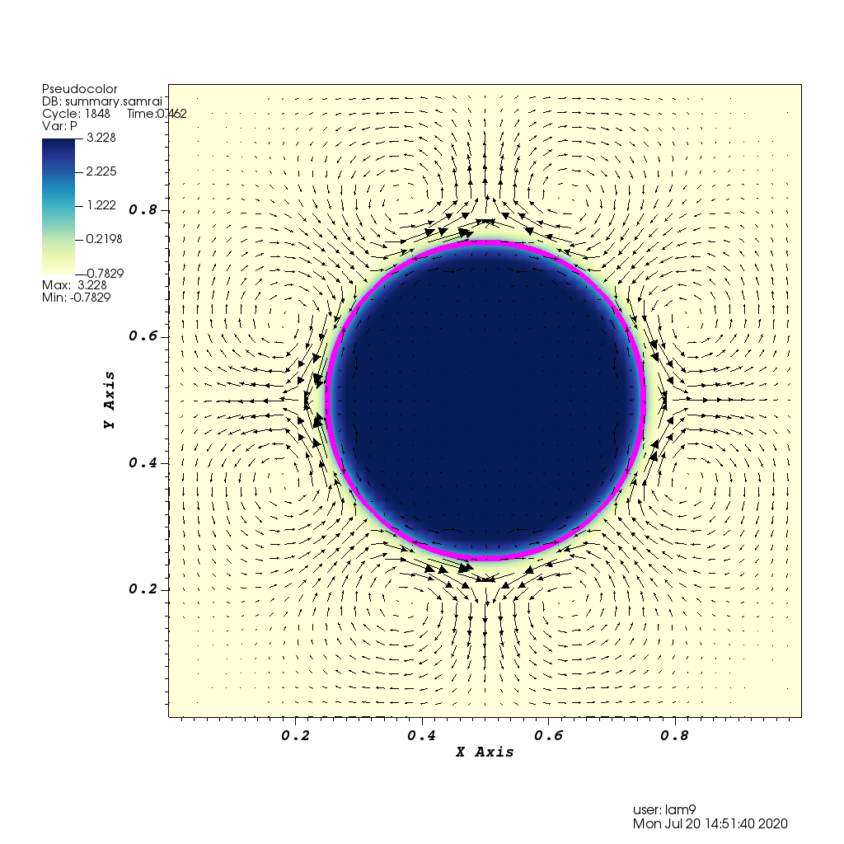
IB example ex0
This is an example of a pressurized rubber band.
The figure shows a color map of the pressure and the resulting velocity vectors.
Input2d was used in this simulation. There is also input2d.shell and input2d.shell_circum_fibers that you can use to make different kinds of rubber bands.

Slide 7
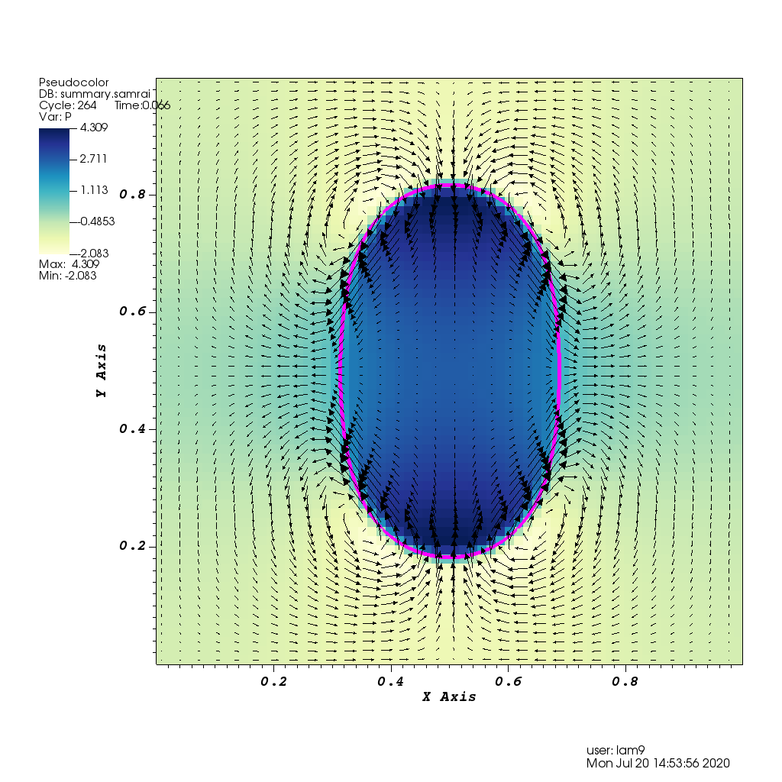
IB example ex1
This is an example of a bouncing rubber band initialized as an ellipse.
The figure shows a color map of the pressure and the resulting velocity vectors.
Input2d was used in this simulation.
As in the other example, there is input2d.shell and input2d.shell_circum_fibers.
There is also a 3D shell you run with input3d.
Be sure to change all of the 2’s in the Makefile to 3’s

Slide 8
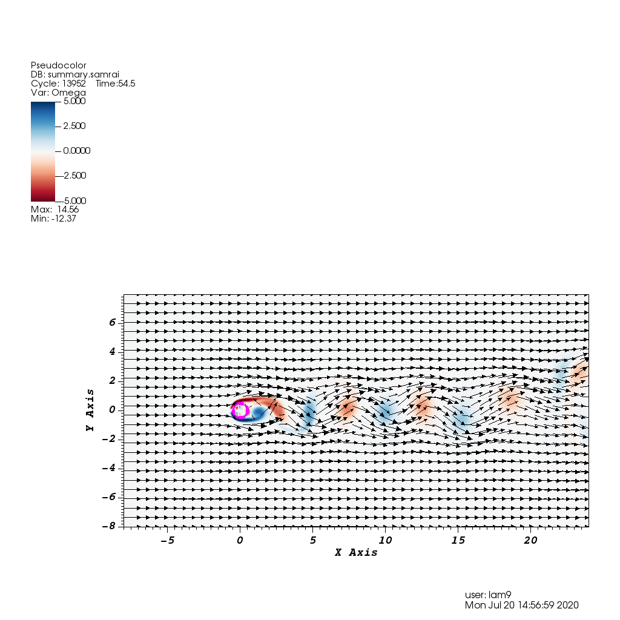
IB example ex2
This is an example of flow past a cylinder.
The example includes analysis files to calculate the Strouhal number.
The figure shows a color map of the vorticity and the resulting velocity vectors.
Input2d.cylinder was used in this simulation.
There is also a 3D cylinder and a sphere with corresponding input files.
Be sure to change all of the 2’s in the Makefile to 3’s

Slide 9
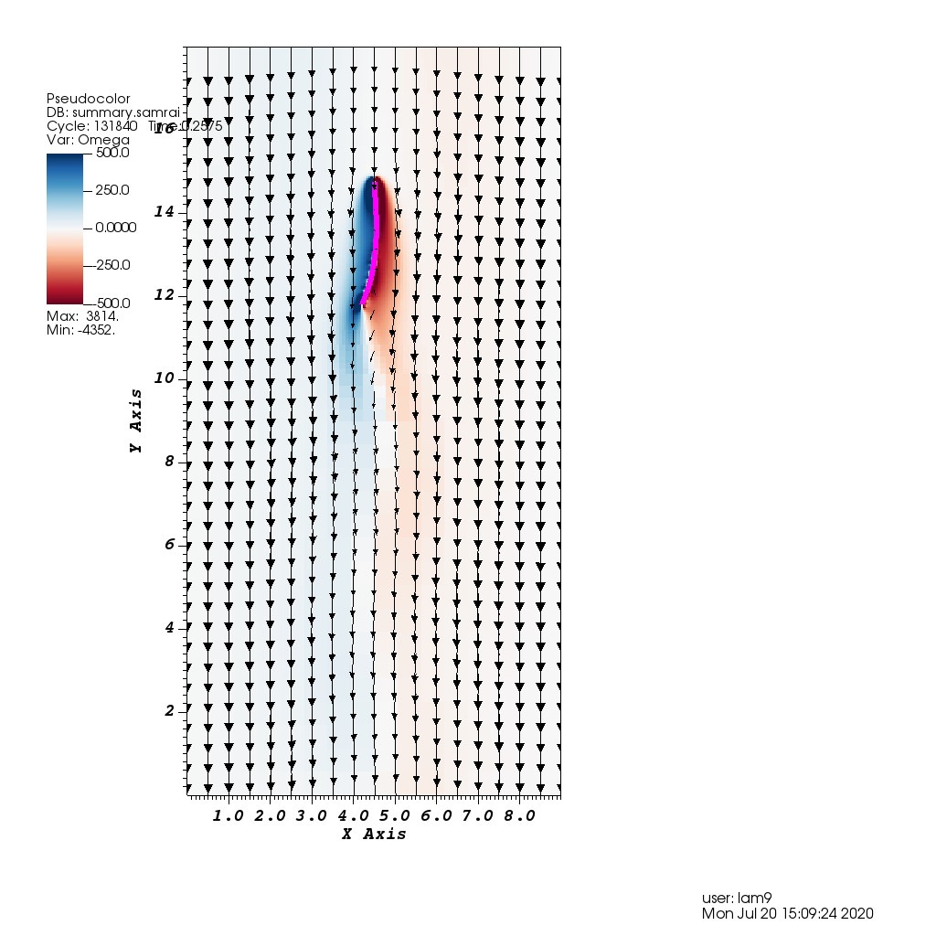
IB example ex3
This is an example of flow past a flexible, tethered filament.
The figure shows a color map of the vorticity and the resulting velocity vectors.
This example was inspired by a paper by Zhu and Peskin.
Go to the google drive papers folder to find it.

Slide 10
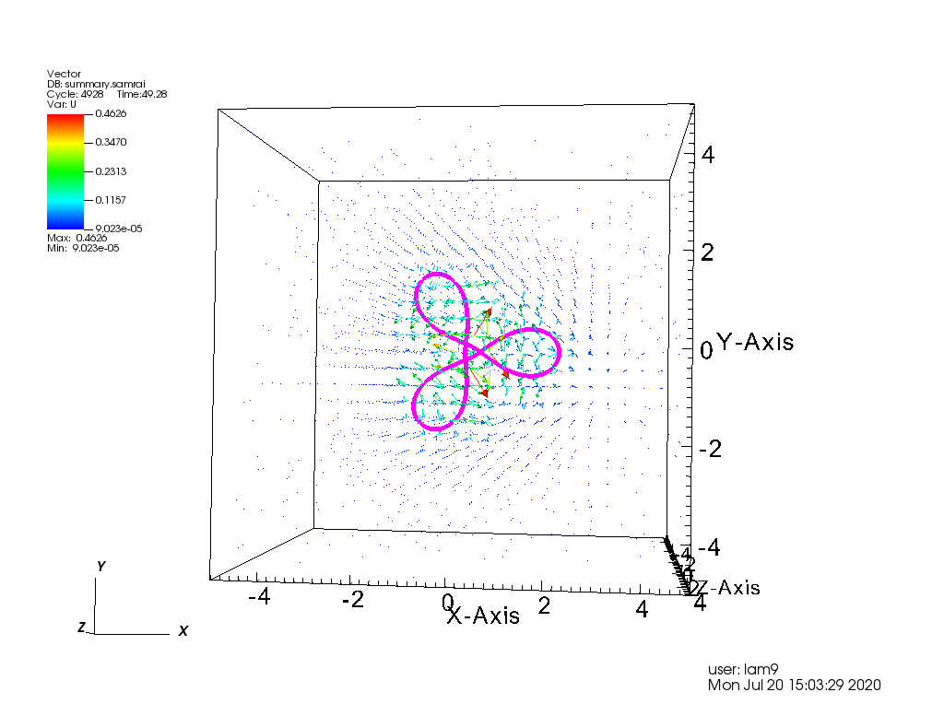
IB example ex4
This is an 3D example of a rubber band that starts out as a circle that is loaded with torsion.
The infinitely thin boundary can apply rotational forces to the fluid.
Eventually the rubber band twists in 3D as seen in this snapshot.
Griffith, Boyce E and Lim, Sookkyung. Simulating an Elastic Ring with Bend and Twist by an Adaptive Generalized Immersed Boundary Method. Communications in computational physics, ISSN 1815-2406, 08/2012, Volume 12, Issue 2, pp. 433 – 461.

Slide 11
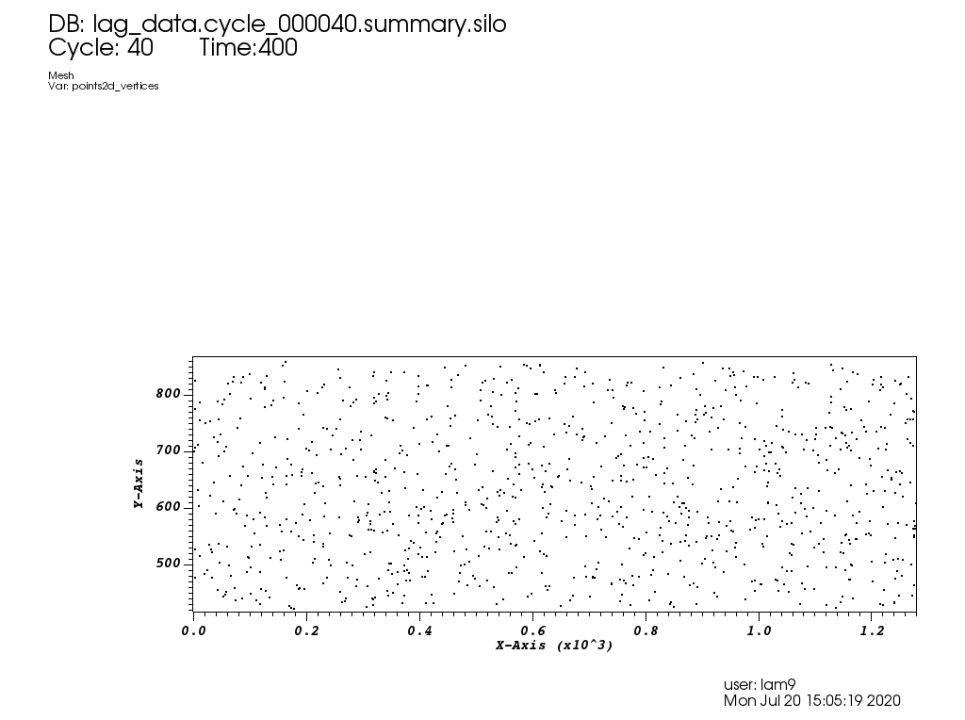
IB example ex5
This example includes a bunch of immersed boundary points that each move with their own behavior.
The vertices and their x, y-coordinates are outputted, but the flow fields are not.

Slide 12
CIB Examples
An Immersed Boundary Method for Rigid Bodies
Bakytzhan Kallemov, Amneet Pal Singh Bhalla, Boyce E. Griffith, and Aleksandar Donev
This paper is on the google drive. Note that it is the more recent paper for two different methods used for rigid body simulations.
Some of the examples considered in this paper appear in these CIB examples.

Slide 13
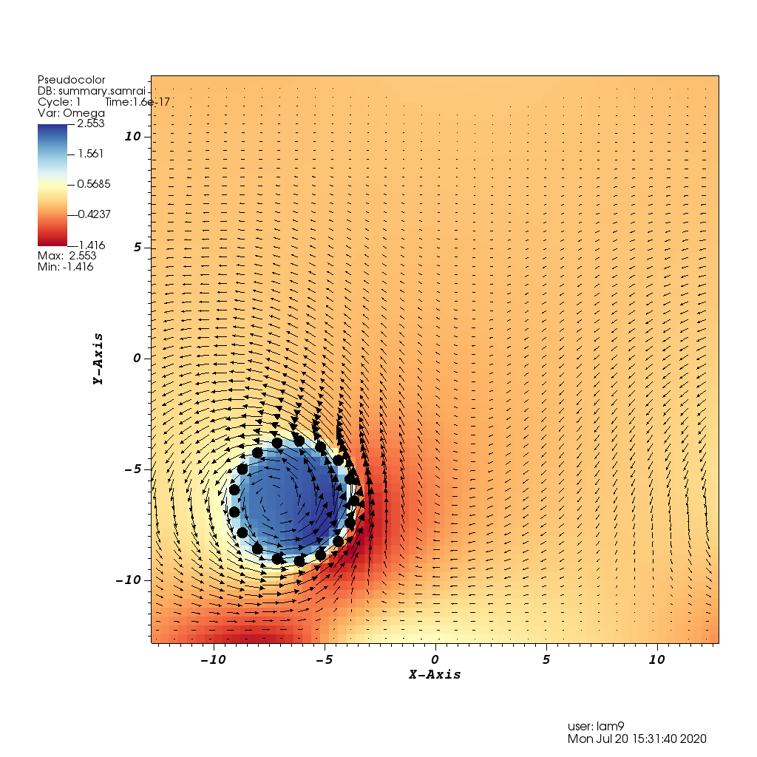
CIB example ex0
This example is basically a cylinder in 2D that rotated in a prescribed way.
I only had two time steps that wrote to a visualization file, and checking the input file this example only runs one DT.
From the README, “This example shows how to set various solvers for a fully prescribed kinematics for a 2d body.”

Slide 14
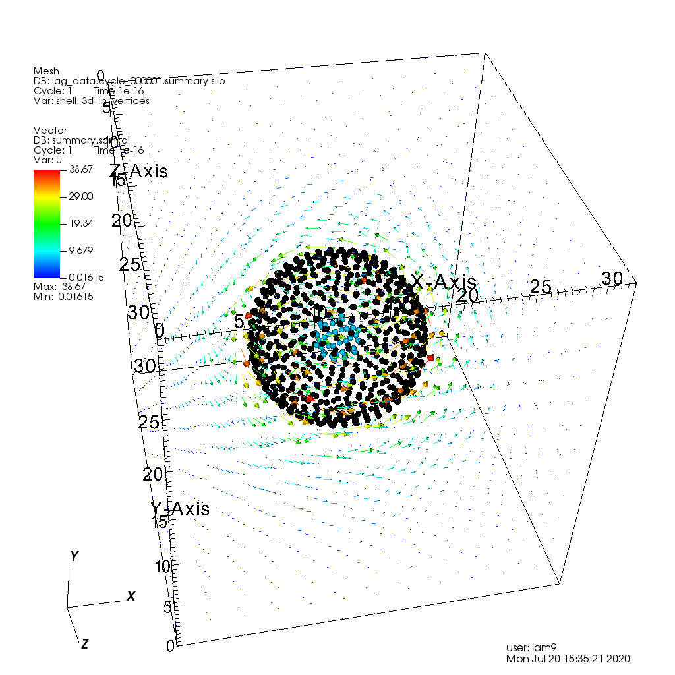
CIB example ex1
This example is basically a 3D shell with a smaller 3D shell (blue dots) inside it.
I believe that this is the example in the paper of Stokes flow between two concentric spherical shells.
This example also only runs one DT.
From the README, “This is an example of mixture of prescribed and free DOFs for two bodies. The outer shell (structure 0) moves relative to the inner sphere (structure 1). The mobility matrices (both fluid and body mobility) of two structures are formed independently and are distributed to different processors (for parallel runs). The hydrodynamic forces and torques on the bodies are computed by integrating the Lagrange multipliers. Forces and torques on both spheres (strct_id_0) and the inner sphere (strct_id_1) are computed via control volume analysis.

Slide 15
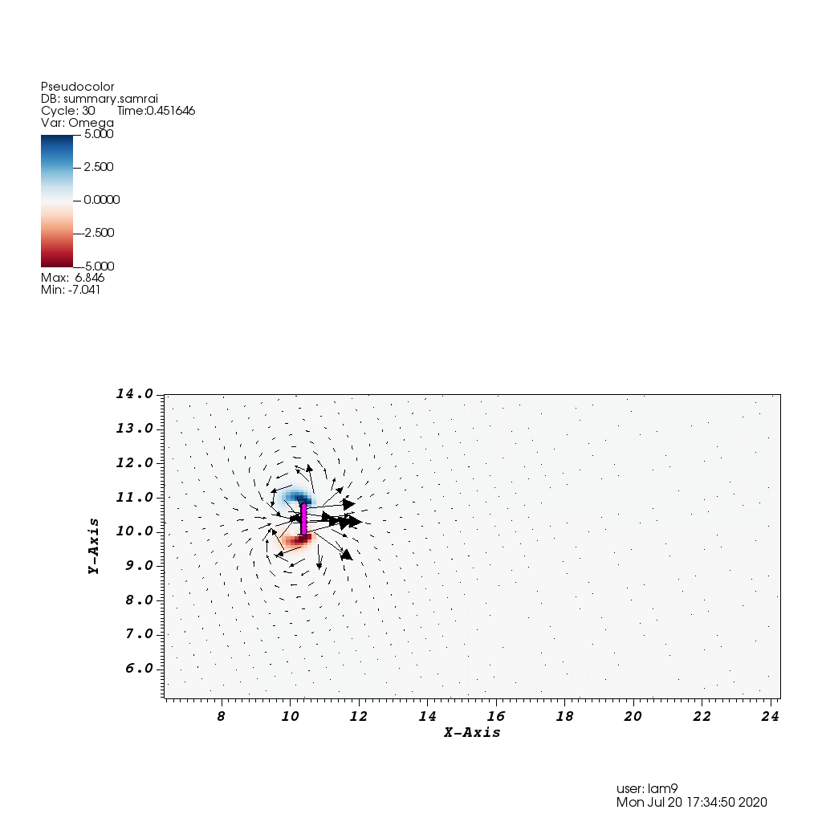
CIB example ex2
From the README, “A 2d plate is dragged with an imposed velocity for a certain time, after which it translates freely but with locked rotational motion.”
This example outputs many times. In the 2 hour debug queue I don’t see rotation.

Slide 16
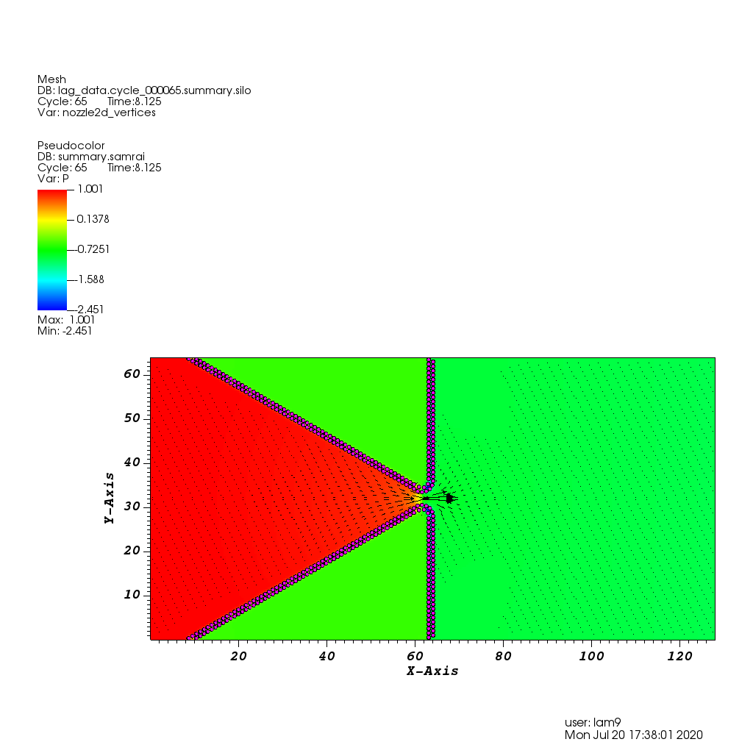
CIB example ex3
This example shows flow through a nozzle.
The snapshot shows the velocity vectors and the color map shows the pressure.
This example comes directly from the paper in the section on flow through a nozzle.

Slide 17
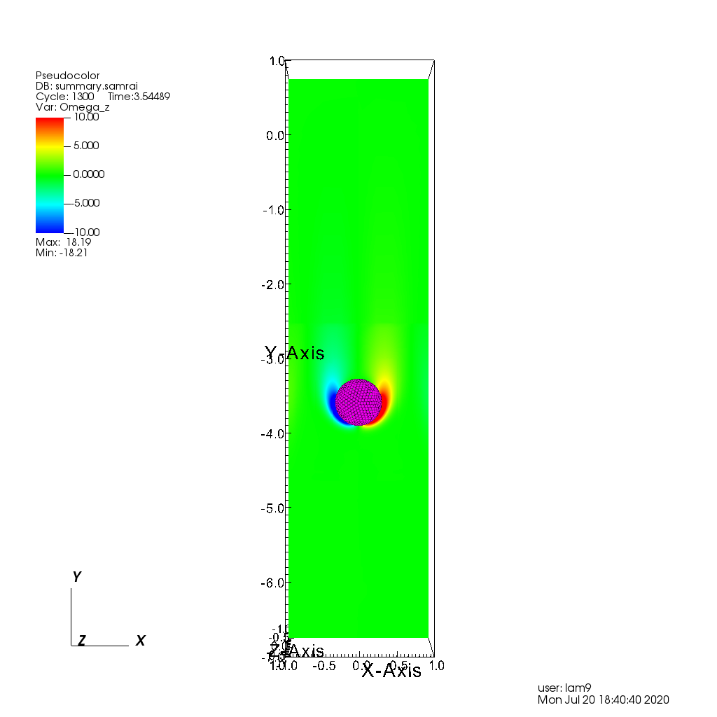
CIB example ex4
This is a 3D example shows a falling sphere.
The snapshot shows the out of plane vorticity in a 2D slice.
The movement of the sphere is driven by gravity. I don’t believe this example is in the paper, look at the code to see how it is handled.

Slide 18
Constraint IB Examples
A unified mathematical framework and an adaptive numerical method for fluid–structure interaction with rigid, deforming, and elastic bodies
Amneet Pal Singh Bhalla, Rahul Bale, Boyce E. Griffith, Neelesh A. Patankar
This paper is on the google drive. Note that it is the first paper for rigid body simulations.
Nearly all of the examples considered in this paper appear in these Constraint IB examples. Some examples are also similar to the CIB ones.
Some of the examples generate HUGE numbers of files.

Slide 19
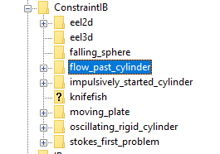
Constraint IB Examples

Slide 20
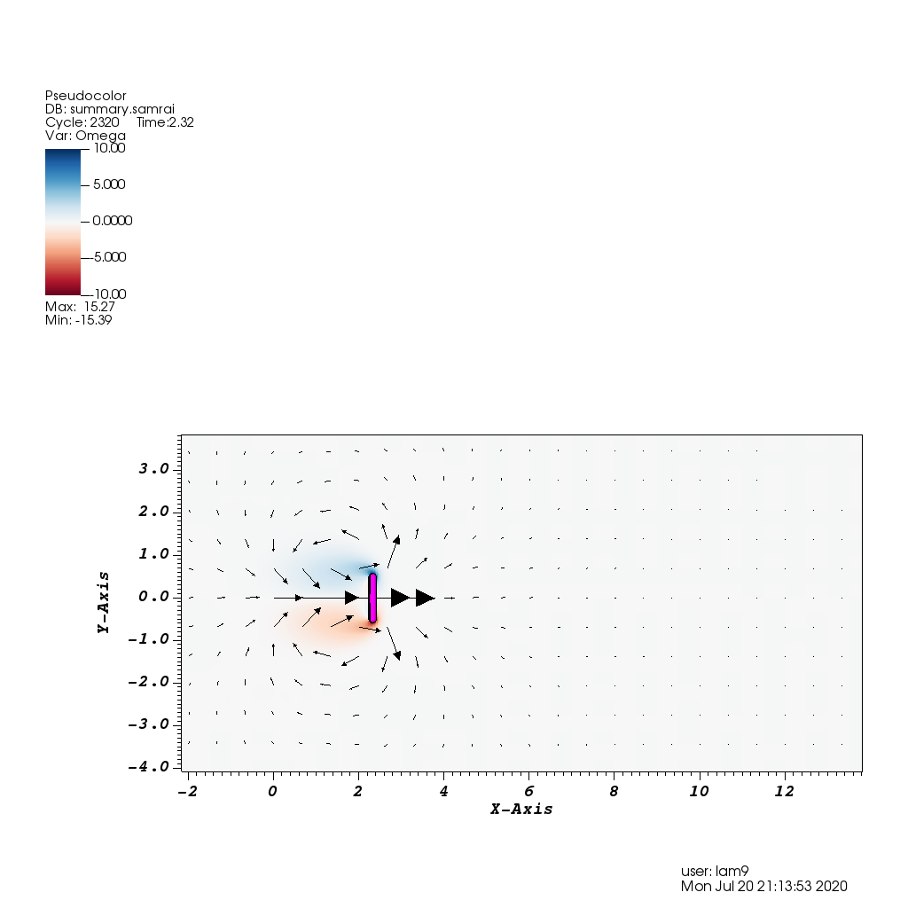
Constraint IB – moving plate
This example is that of a finite plate of height b in an infinite quiescent flow that is dragged perpendicular to itself with a constant velocity U0.
This example corresponds to section 7.1.2, a moving plate in an infinite flow.
This is an example of prescribed motion.

Slide 21
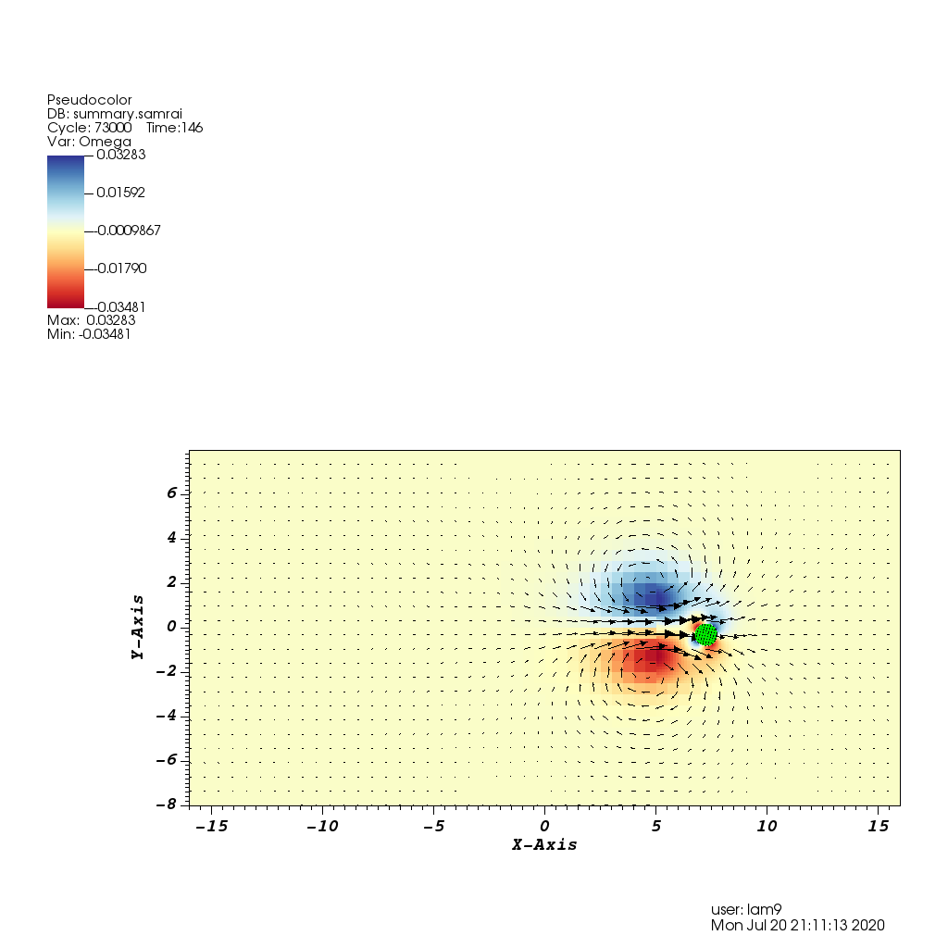
Constraint IB – impulsively_started_cylinder
This example appears in the paper in section 7.2.2.
“We take the case of impulsively started cylinder in a quiescent flow to demonstrate the momentum-conservation properties of our method. A cylinder of diameter D ¼ 1 m is placed the center of a periodic domain of size 32 m x 16 mat time t = 0. An impulse of the form I(t) = 400 exp(-400t) N/m^3 is applied in the x direction within the body, at its initial position, thereby impulsively starting its motion.
This is an example of rigid body motion.

Slide 22
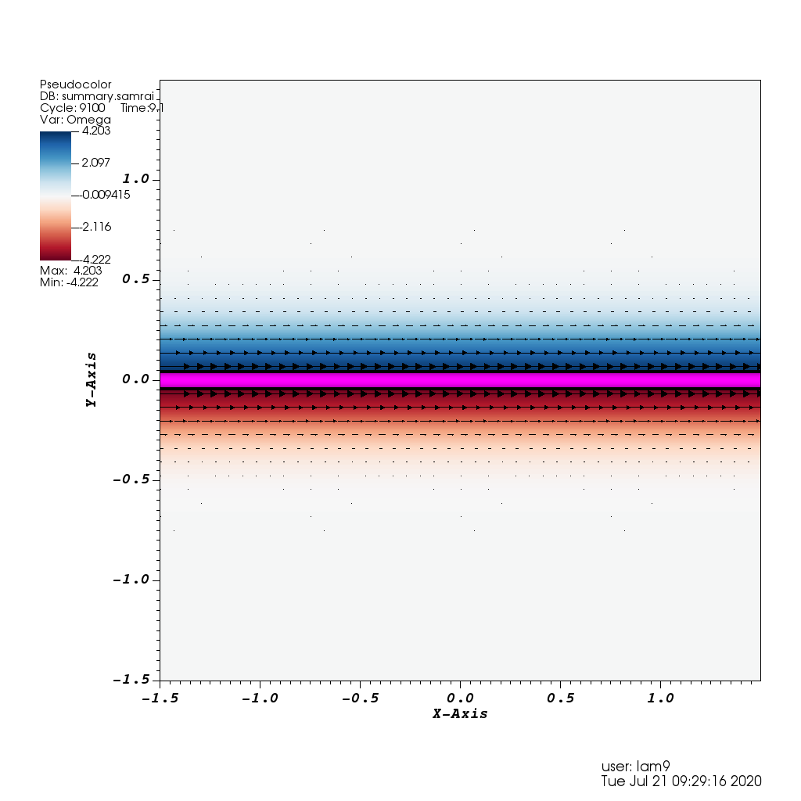
Constraint IB – stokes_first_problem
This example appears in the paper in section 7.1.1.
“Our first example considers Stokes’ first problem, in which an infinitely long horizontal plate is impulsively started with a velocity U0 in the x direction.
This is an example of prescribed motion.

Slide 23
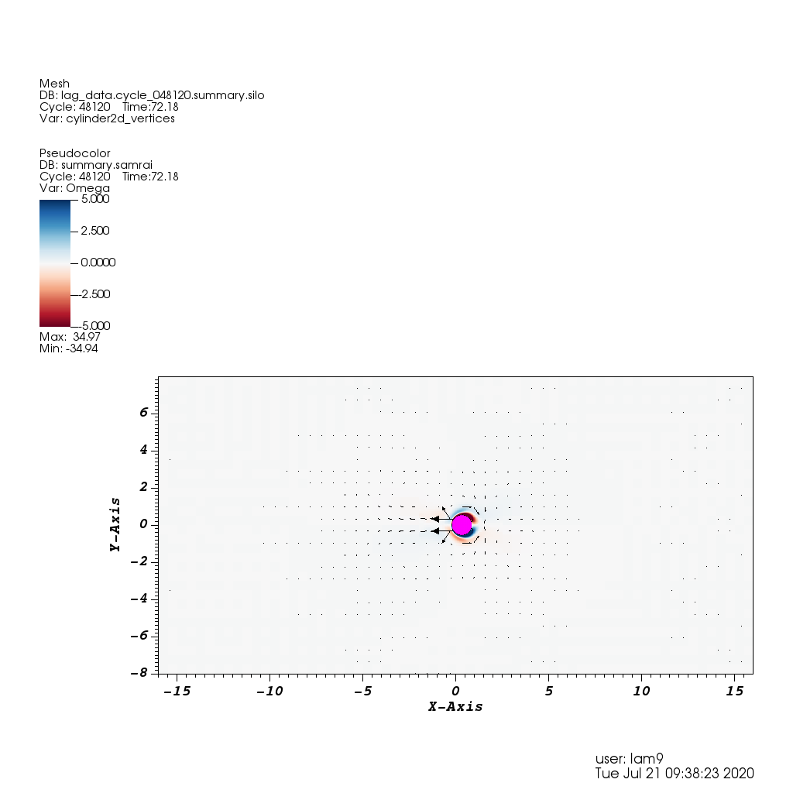
Constraint IB example – oscillating_rigid_cylinder
This is a prescribed motion example from 7.1.4.
“In cases in which the body has a nonconstant specified velocity, contributions to the drag forces come from both inertial and constraint forces. In this example, we consider a rigid circular cylinder oscillating about a mean position in a quiescent fluid.”

Slide 24
Other constraint IB examples
Other examples include free swimming cases of eel swimming in 2D and 3D as well as a 3D knifefish.
I have run the 2D eel, but the download is taking too long to show today.
It is worth running the 3D eel and knifefish as well.
There is also a falling sphere example of rigid body motion in 3D.
“We validate our algorithm for a freely moving body by considering the problem of a sedimenting sphere. To treat this problem with our present formulation and implementation, which assume that the mass density of the fluid–structure system is uniform, we impose a gravitational body force that is present only in the solid region Uc of the physical domain U.”

Slide 25
More examples next week
For next week, I’d like to go through the non-Newtonian and level set examples. Then I’d like to revisit the IBFE ones.
I encourage you to run and look at examples that are related to your target applications and discuss them next week.

